Slide 1
The Relationship Between Rideshare Usage
and Alcohol Related Crimes in Austin
Allison Bolger, Arunima Menon, Adam Newlyn, Jay Schwan
Notes:
Jay

Slide 2
Motivation and Summary
With the growing popularity of ridesharing in the US, we were inspired to find a correlation between rideshare usage and instances of alcohol related crimes.
Our hypothesis is that we believe as rideshare usage increases, alcohol related crimes decrease.
More specifically, we aimed to answer:
As ride usage increases, does the incidence of alcohol related crimes decrease?
What times of year see the most rideshare usage and crime?
What times of day see the most rideshare usage and crime?
Do alcohol related crimes decrease in areas with more rideshare usage?
Is higher rideshare usage concentrated around areas with more bars?
Are higher alcohol related crime rates concentrated in areas with more bars?
Notes:
Jay

Slide 3
Motivations and Summary, cont.
While it would seem intuitive that alcohol related crimes went down as rideshare usage increased, we actually found little correlation between the two.
The data suggests that rideshare usage and alcohol related crimes increase at similar levels throughout the year and over time of day, but the rates are not consistent for both and one does not entail the other.
There is data to suggest that both rideshare usage and crimes decrease over the summer months.
Notes:
Jay

Slide 4
Data Exploration
Why Austin?
Crime and Rideshare data was readily available on DataWorld for Austin, thus Austin became our sample city.
We found two CSVs, one for Crimes occurring between 2003-2019 and one for Rides during 2016-2017. Both CSVs included data on:
Location - both CSVs had data points on location by latitude and longitude
Date/Time - both CSVs had date and time information
We decided to use the Google Maps API to call crime, data, and bar locations
Notes:
Allison

Slide 5
Data Munging - Crime Data
Excess Data - we deleted any unnecessary columns and dropped na values.
Crime Types - we filtered out all crimes that were not alcohol related.
Dates - We cut the Crime data to include only occurrences during the same time frame as the rides.
Date/Time - we added a “Date” column and formatted as datetime object.
Notes:
Allison
Show crime data cleaning Jupyter notebook

Slide 6
Data Munging - Ride Data
Excess Data - we deleted any unnecessary columns and dropped na values.
Bounds - we called the Google Maps API to find the city boundaries of Austin in latitude/longitude and deleted any data points with rides that were not actually in Austin
Date/Time - we added a “Date” column and formatted as datetime objects.
Notes:
Show rideshare cleaning Jupyter notebook
Adam

Slide 7
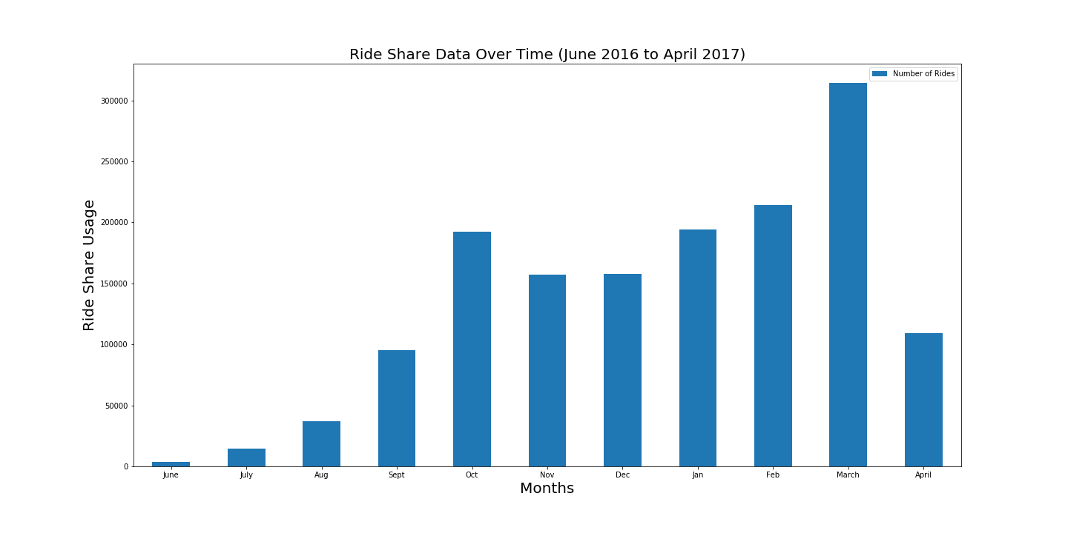
Rideshare Occurrences Over Time
Notes:
Arunima
View Jupyter Notebook

Slide 8
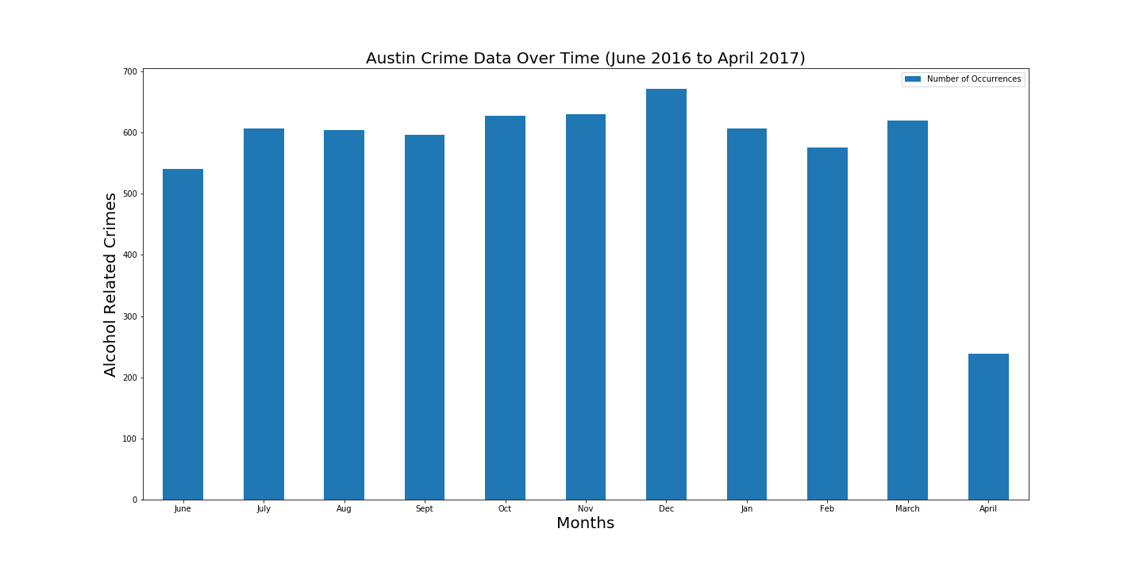
Alcohol Related Crime Occurrences over Time
Notes:
Arunima
Show bar chart Jupyter notebook

Slide 9
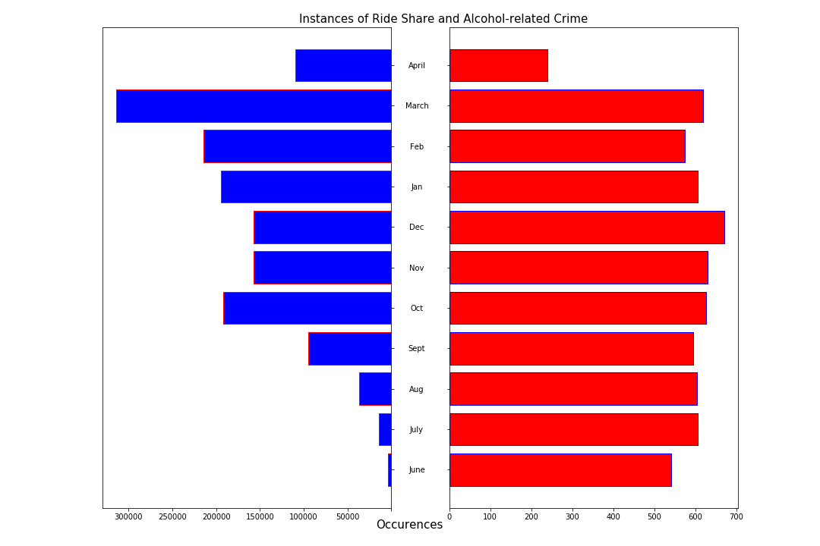
Rideshare and Crime Occurrences
Over Time
Notes:
Arunima
View Jupyter Notebook

Slide 10
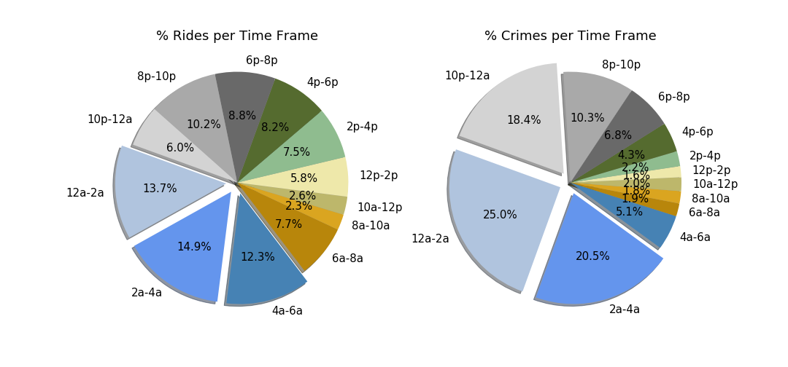
Ride and Crime Occurrences
by Time Frame
Notes:
Allison
Show jupyter notebook
We can see that the majority of crimes and rides happen between the hours of 12am - 4am, and both slow down in the later morning hours.
This could be due to the bar closing hour of 2am.

Slide 11
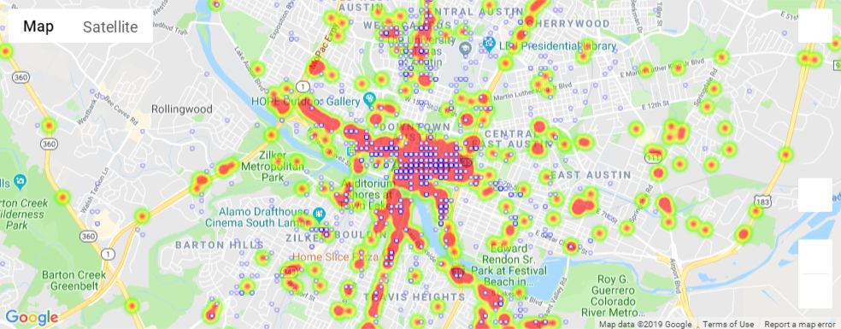
Ride Points vs Crime Heat Map
Notes:
Adam
show jupyter notebook

Slide 12
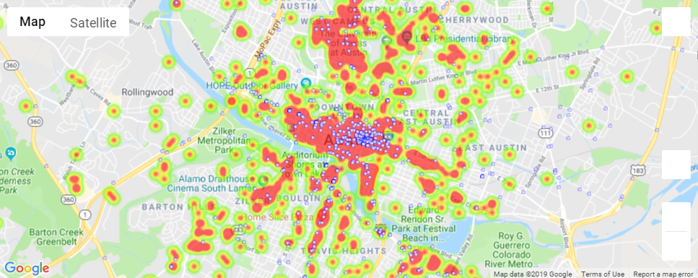
Crime points vs Ride Heat Map
Notes:
Adam

Slide 13
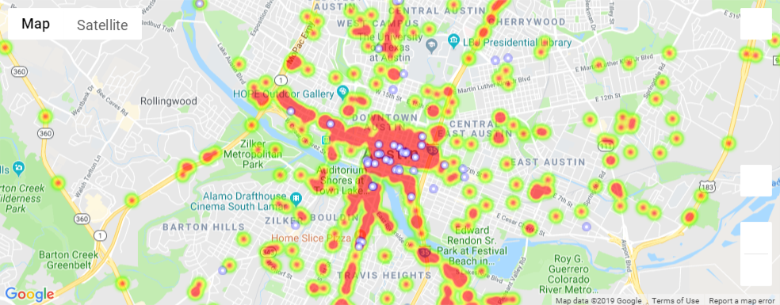
Bar Points vs Crime Heat Map
Notes:
Adam

Slide 14
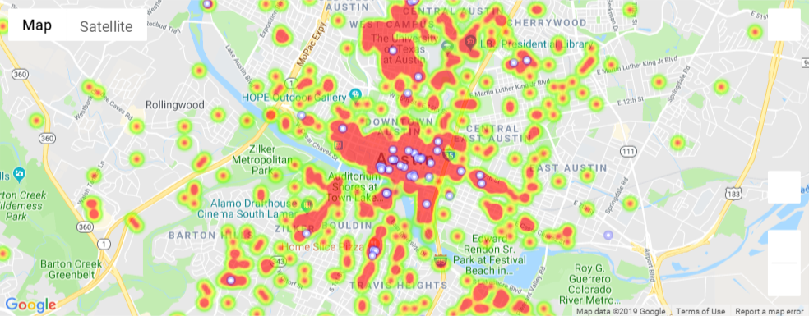
Bar Points vs Ride Heat Map
Notes:
Adam

Slide 15
Discussion
Based on our findings and analysis, the data suggests that there is not any correlation between rideshare usage and incidents of alcohol related crime.
Crime tends to remain flat over time of year regardless of the amount of ride share usage. There does seem to be more rideshare usage than crime occurring around bars, but the data doesn’t provide enough insight as to why.
Of interest is the observation that alcohol related crime did not spike with occurrence of the SXSW Festival in March nor did crime rates drop significantly while school was out of session over the summer of 2016(June to Sept.). Also, crimes rates saw a small drop when there was no rideshare data to report.
Notes:
Jay

Slide 16
Post Mortem
Some of questions have a time parameter that was particularly tricky to work with. We had to learn how to convert different date formats to a standardized date data type. We chose to convert all of our dates to datetime objects in order to better slice the data over time.
We also had to figure out an effective way to localize our Google Maps to the same parameters as our geolocation data from both data sets. Adam was able to import a boundary API from Google that allowed us to operate inside Austin city limits and get only pertinent information from Google Maps for bar locations.
We feel that given enough time and more historical data, we could draw some additional conclusions to see how crime rates fluctuate over time in an era before ridesharing.
Notes:
Jay

